Slide 1
Clustering with User Generated Content UGCA, October 10, 2017
Anitesh Barua
aniteshb@gmail.com

Slide 2



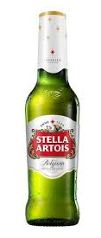
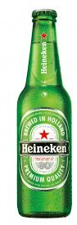
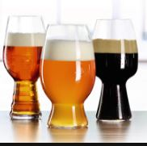

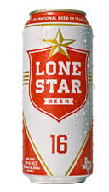

Building Recommendation Systems
Source: Kyle Katzen et al. (2017)
Notes:
Gihani
Took surveys of 10 beers

Slide 3
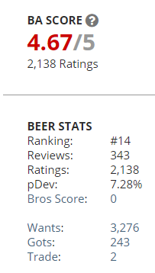
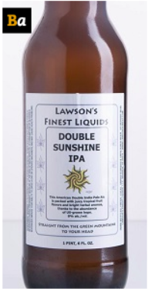
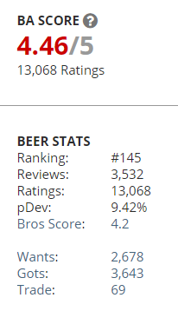
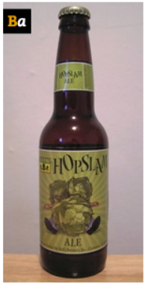
The “Long Tail” Visibility Problem
Similar beers (found using cosine similarity), but one has
much higher demand
Double Sunshine IPA | Lawson's Finest Liquids
Hopslam Ale | Bell's Brewery, Inc.
Great product,
but not well known
(visibility problem)
Very good product,
very well known
Source: Kyle Katzen et al. (2017)
Notes:
Kyle
Answer to previous slide is that it depends how you define popular!
Better marketing and increasing production would really help the double sunshine

Slide 4
Clustering with Text
Grouping documents that are “similar”
How to measure similarity between documents?
Many approaches: Euclidean distance, cosine similarity
Similarity within a “cluster”:
Similarity between “clusters”:
Check test_clustering.py for illustration
Not a “supervised” method: I.e., no accuracy of prediction or classification
A cluster has to be interpreted

Slide 5
Business Applications
Grouping customer comments.
E.g., customer complaints
check customer complaints clustering.xlsx & cosinesimilarity_complaints.py
Ideas provided by customers (e.g., ideastorm.com)
Discussions on product forums or review pages
Finding similar products (e.g., movies, cameras, apps, etc.)
Check movie_clustering.py

Slide 6
Clustering Top 100 IMDb Movies Based on Synopses
Preprocess descriptions
Transform data into vector space using tf-idf (or other approaches)
Calculating Euclidean distance or cosine similarity between each document
Cluster using k-means clustering
Use MDS and visualize
Source: http://brandonrose.org/clustering

Slide 7
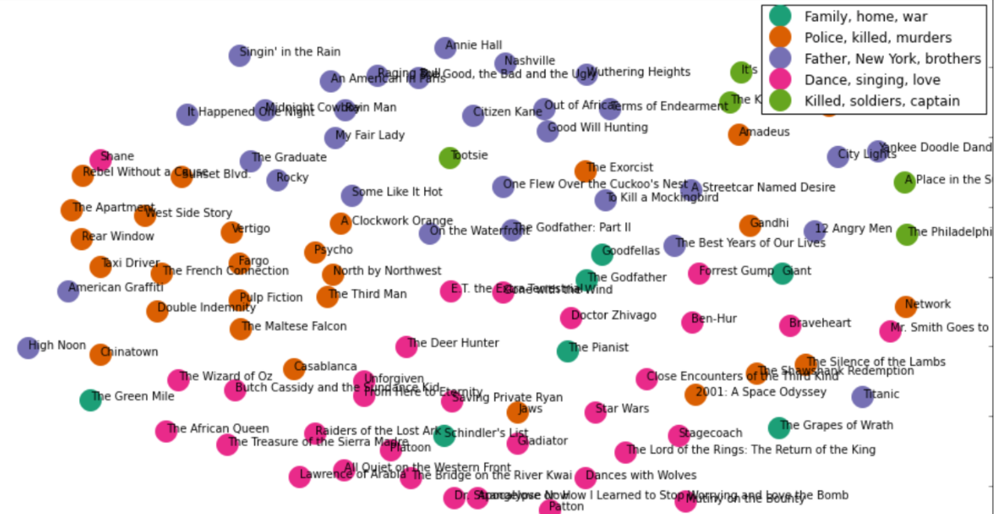
MDS of Top 100 Movies
Source: http://harrywang.github.io/document_clustering/

